Slide 1
CV Analysis
CAPSTONE PROJECT
Presented By:
1. Jani Madhav D – [Shri Labhubhai Trivedi Institute of Engineering & Technology, Rajkot] – (Computer science engineering)

Slide 2
OUTLINE
Problem Statement (Should not include solution)
Proposed System/Solution
System Development Approach (Technology Used)
Algorithm & Deployment
Result
Conclusion
Future Scope
References

Slide 3
Problem Statement
"Inefficient manual CV screening processes pose challenges in recruitment, leading to time delays and potential oversight of qualified candidates. To streamline and enhance this process, there is a need to develop an automated system for comprehensive CV analysis, leveraging NLP and machine learning techniques to improve recruitment efficiency and decision-making."

Slide 4
Proposed Solution
"Our proposed solution involves developing a robust automated system that utilizes advanced Natural Language Processing (NLP) techniques and machine learning algorithms to analyze and evaluate CVs effectively. The system will first preprocess CV data to extract key information such as education, work experience, skills, and achievements. Next, it will apply NLP models to understand the context and relevance of this information to job requirements.. The solution will consist of the following components:
Data Preprocessing and extraction:
Develop algorithms to preprocess CVs and extract key information such as education, work experience, skills, and achievements using NLP techniques.
Normalize and structure extracted data into a standardized format for analysis.
Semantic Understanding and Matching:
Implement advanced NLP models to understand the semantic context of extracted information relative to job requirements.
Develop algorithms to match CV content with specific job descriptions, assessing relevance and suitability
Machine Learning Algorithm:
Utilize machine learning algorithms (such as classification and ranking models) to evaluate CVs based on predefined criteria and job-specific attributes..
Train models on labeled data to predict candidate suitability and rank applicants accordingly..
Continuous Improvement and Feedback Mechanisms:
Incorporate mechanisms for feedback from recruiters to continuously improve the accuracy and effectiveness of the CV analysis system.
Implement automated learning processes to adapt to evolving recruitment trends and job market dynamics.
Benefits and Outcomes:
Improve decision-making accuracy and reduce the likelihood of overlooking qualified candidates.
Enhance overall recruitment efficiency, leading to faster hiring cycles and improved candidate experience.

Slide 5
System Approach
The "System Approach" section outlines the overall strategy and methodology for developing and implementing the CV Analysis . Here's a suggested structure for this section:
Data Acquisition and Storage :Collect CV data from various sources and store it securely.
Data Preprocessing and Standardization :Extract and standardize key information from CVs using NLP techniques.
Machine Learning Models for CV Analysis :Develop models to evaluate CVs against job requirements and rank candidates.
Integration with Recruitment Workflow :Integrate CV analysis capabilities with existing recruitment systems for seamless operation.
User Interface and Visualization :Design intuitive interfaces and dashboards for recruiters to view and interpret analysis results.
Security, Privacy, and Bias Mitigation :Ensure data security, privacy compliance, and implement bias detection/mitigation measures.
Continuous Improvement and Feedback Mechanisms :Gather feedback to iterate and improve system accuracy and usability.
Deployment and Scalability :Deploy on scalable infrastructure to handle increasing volumes of CVs efficiently.

Slide 6
Algorithm & Deployment
In the Algorithm section, describe the machine learning algorithm chosen for CV Analysis. Here's an example structure for this section:
Algorithm Selection:
Selection of algorithms should be task-based, for instance: NLP in the case of text processing, machine learning in the case of classification.
Represent texts with algorithms such as TF-IDF and word embeddings like Word2Vec and GloVe.
Classify candidates using classification algorithms, such as SVM or Random Forest, and rank candidate preferences.
Implement NLP techniques such as named entity recognition and sentiment analysis in a resume information extractor.
Deployment Strategy:
Deploy the system on a cloud service that can grow with us, like AWS or Azure. This way, we can add more resources when we need them, and it's easier to manage everything.
Use container technology, like Docker, to package up each part of the application. That way, we can move them around easily and make sure they always work the same way, no matter where they are.
Make sure our system can talk to other recruitment tools we might be using, like ATS, by creating APIs that follow the REST pattern. This way, it'll be really easy for other systems to work with ours.
Keep our users' information safe by using encryption and making sure only the right people can access it. We also need to follow any rules or regulations that might be in place, like GDPR.

Slide 7
Result
The objectives of the CV analysis project are to deliver a number of important benefits, that will transform the efficiency and effectiveness of a recruitment process. The project hopes to significantly reduce the time-to-hire and manual effort associated with CV screening and evaluation by assisting automation & optimization of these processes in recruitment practice. The goal of the project is to improve representation by increasing objectivity in the candidate review process, and subsequently minimizing any biases due to ignoring qualified applicants, through the application of machine learning-based algorithms. The tool directly integrates with Taleo to establish regularized procedures in workflows and data handling as part of recruitment operations. Finally, continuous improvement levers incorporating feedback loops and iterative model refinements will mean that the system is always learning and refining itself to change patterns in hiring and evolving market landscapes.

Slide 8
Conclusion
So, in conclusion - this is the CV analysis project that plans to change the way recruitments are carried with Automation comprising of data. Using technologies like NLP and ML, it aims to automate CV screening, increase decision-making correctness, and save time. Cloud-native &device agnostic, adaptable with scalable backend and highly secure infrastructure, the project is intent on delivering lockdown solutions which are compliant and feature a high rate of integration with existing systems. It raises the bar on candidate experience through equitable consideration and incremental advancement, committed to enhancing hiring performance as well organizational competitiveness in the evolving talent eco-system.

Slide 9
Future scope
﻿In the close to future, the CV search industry can be superior with the aid of AI integration for deeper information of context, multi-channel search including textual content and media, personalized search for records a planned, improved bias assessment, actual-time analytics for sturdy talent control, seamless integration with HR analytics, improved user revel in, information compliance so, international research Purposeless instructional collaboration, and automatic comments mechanisms for transparency and participation. These upgrades intention to improve recruitment efficiency and choice-making at the same time as making sure impartiality and confidentiality.

Slide 10
References
https://www.researchgate.net/publication/335803493_Personality_Evaluation_and_CV_Analysis_using_Machine_Learning_Algorithm
https://ieeexplore.ieee.org/document/9711787

Slide 11
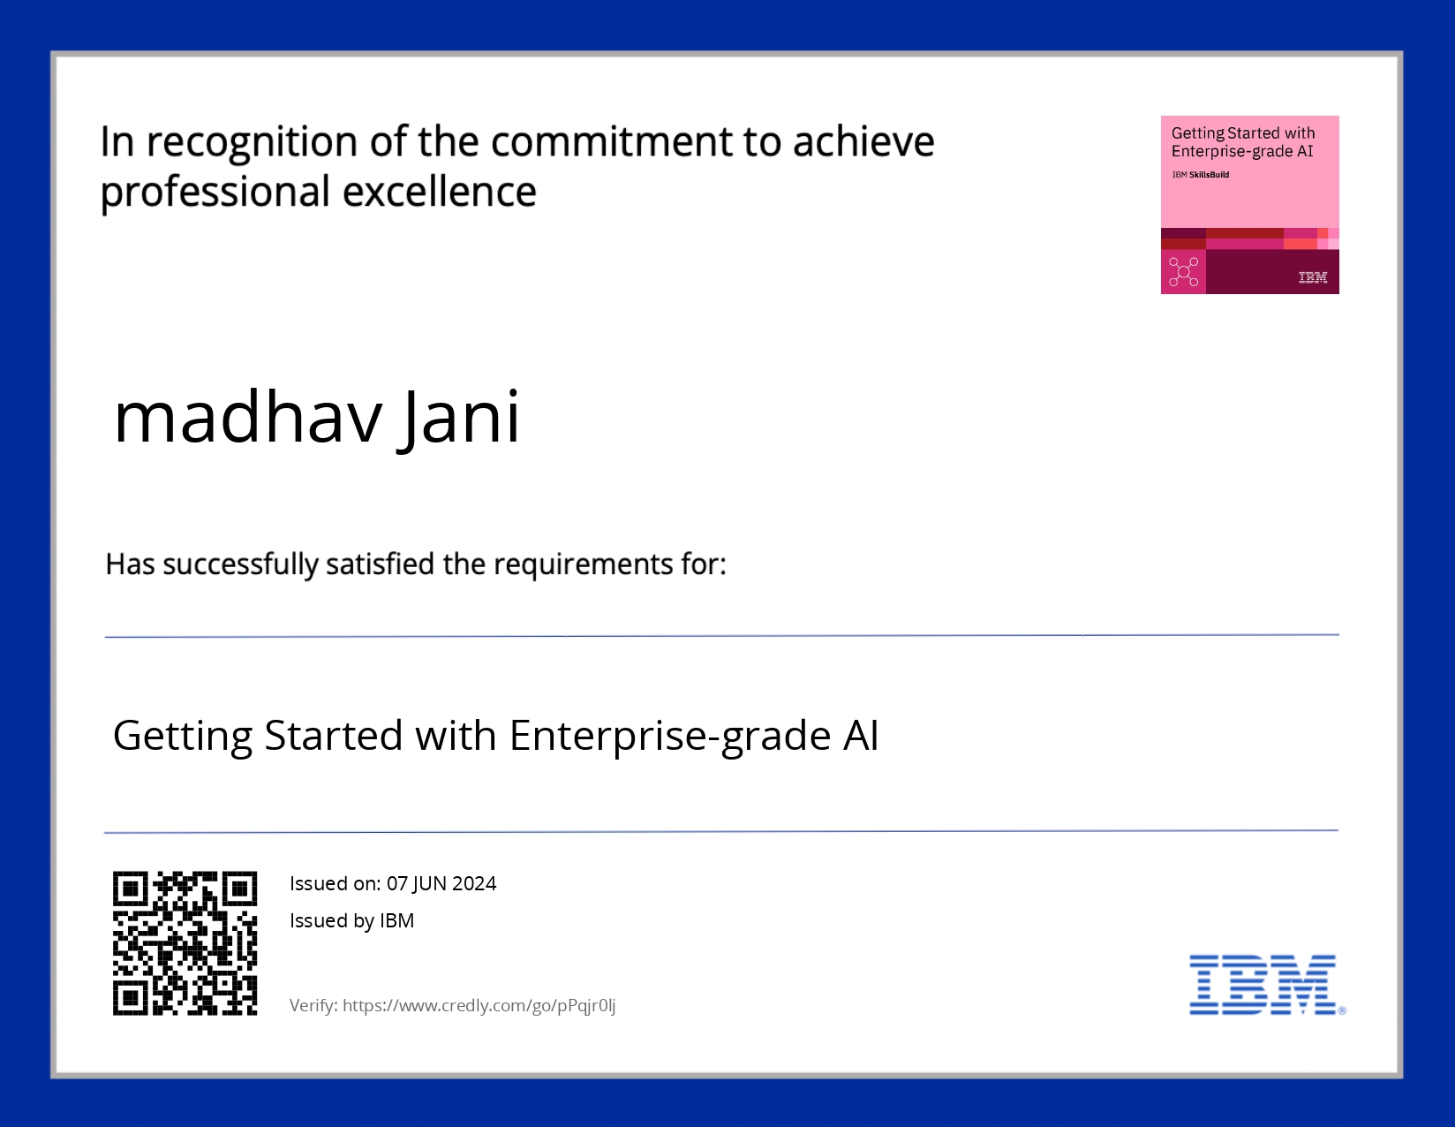
course certificate 1

Slide 12

course certificate 2

Slide 13
THANK YOU

